Slide 1

HTML
CITS3403 and CITS5505 – Agile Web Development
Unit Coordinator: Matthew Daggitt
Semester 1, 2024

Slide 2



Key Web Technologies
HTML - Lecture 2 - describes the semantic content of a web page and the logical relationships between content.
CSS - Lectures 3 & 4 - describes the style and appearance of a web page.
JavaScript - Lectures 5, 6 & 7 - an interpreted language that runs on the client device. It provides the functionality in a web page.

Slide 3
HTML5 basics
Notes:
3

Slide 4
HTML (Hyper Text Markup Language)
HTML was originally defined as a type of SGML in 1990, by Tim Berners-Lee.
HTML5 was a significant revamp of the language released in 2008.
The HTML5 philosophy
1. Interoperability – should be renderable on a wide variety of browsers.
2. Graceful error recovery – small errors should not stop the page from rendering.
3. Backwards compatible – new features should not break the web.
4. Prioritise users – User > Web Designer > Browser Implementer > Theorists.
5. Separation of concerns – describe the type of information, not how it displays.

Slide 5
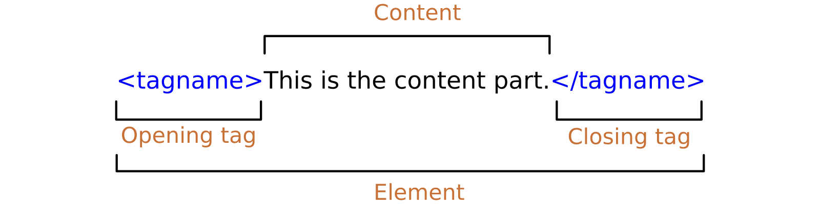
HTML elements
An HTML document is made up of elements.
An element is usually made up of opening and closing tags with content between.
An element's content may contain further elements within it.
HTML is therefore a tree data structure.

Slide 6
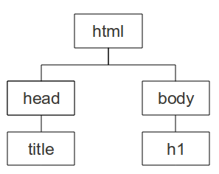
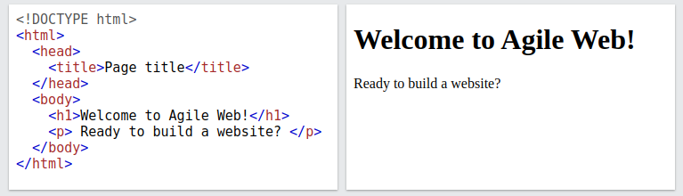
HTML document structure
HTML5 documents begin with a <!DOCTYPE html> declaration.
The document has a <html> tag as its root.
A document consists of a <head> and a <body>.
The <title> tag is used to give the document a title, which is normally displayed in the browser’s window title bar.
Visible elements are on <body> branch

Slide 7

HTML validity
In keeping with the HTML5 philosophy, web browser renderers are very relaxed!
Browers ignore:
Unrecognised tags
Line breaks
Tabs, Multiple spaces
No need to have key document tags such as <html>, <head>, and even <body>
No need to have matching opening and closing tags (but you really should as it an easy source of bugs!)
Tags are only suggestions to the browser, can be ignored (even if they are recognized by the browser!)

Slide 8
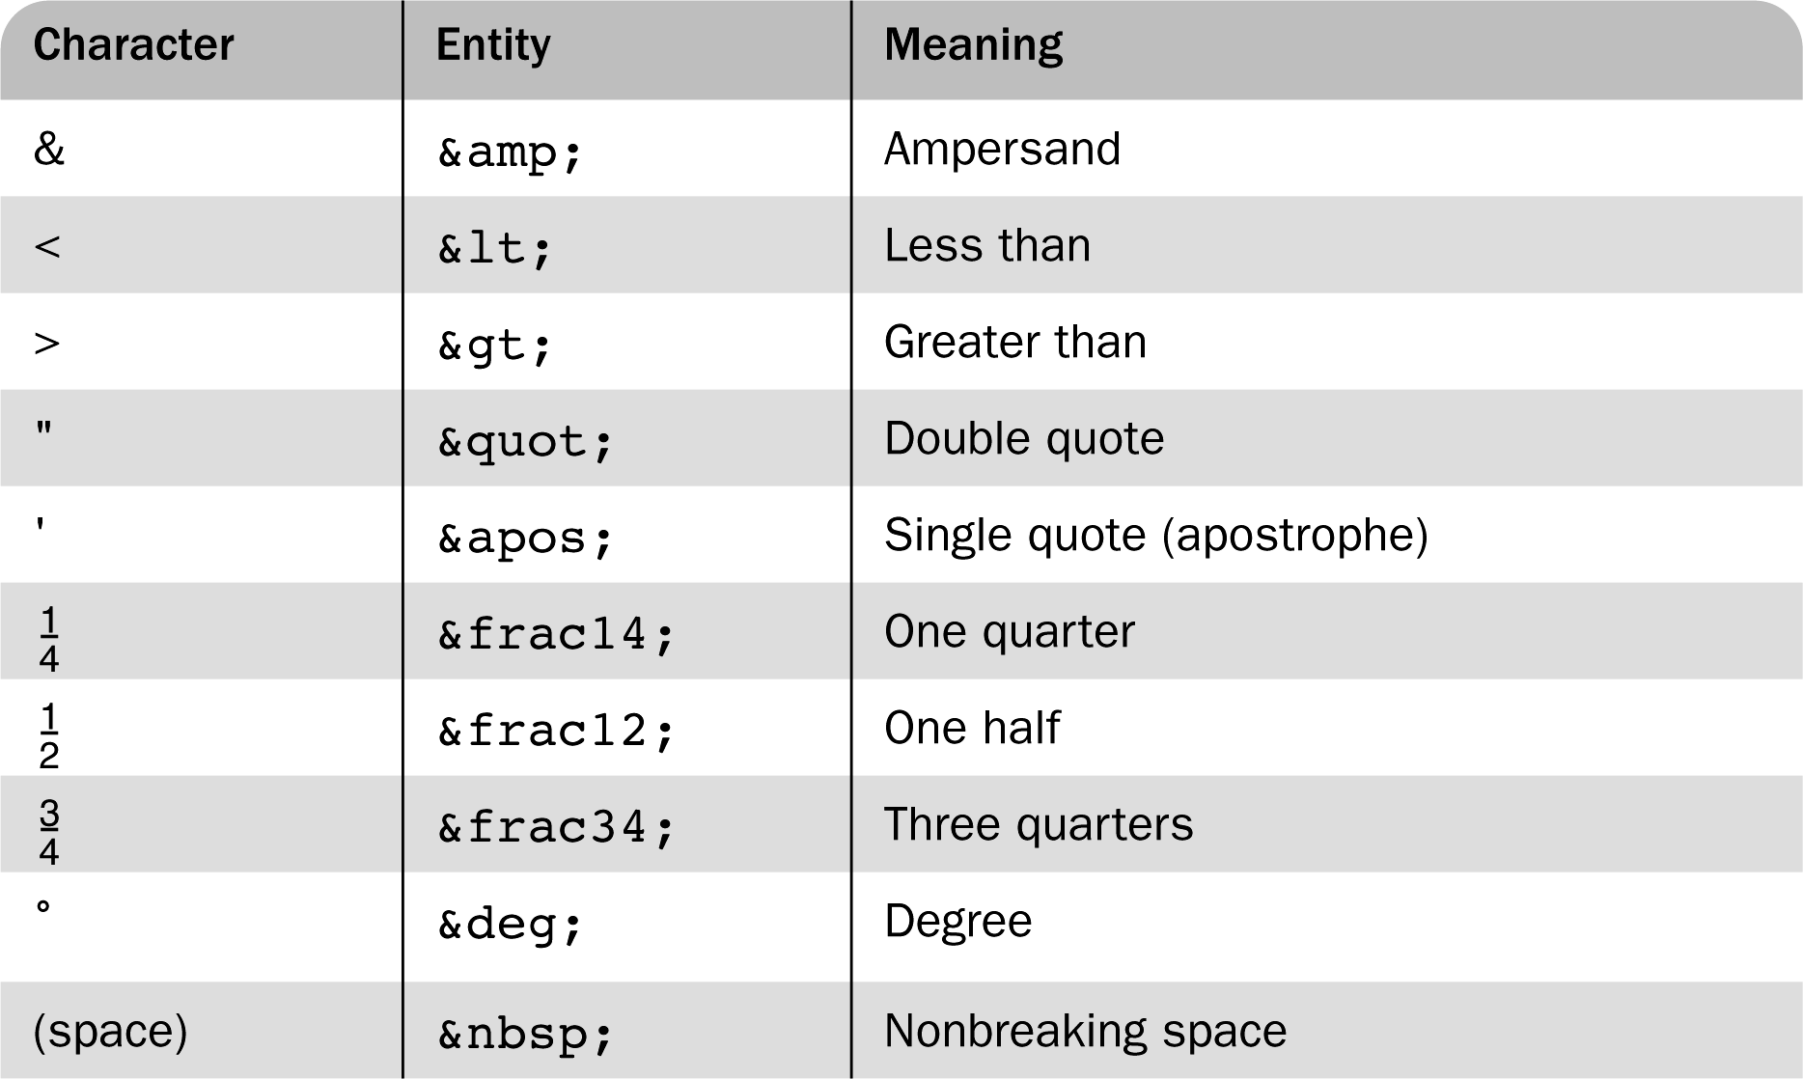
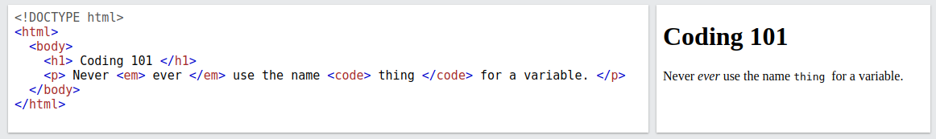
HTML text
Text can be included as the content of many elements:
Headings: <h1>, <h2>, <h3>, <h4>
Paragraphs: <p>
Code: <code>
Emphasis text: <em>
All these can be nested.
Various special characters use `&…;`

Slide 9
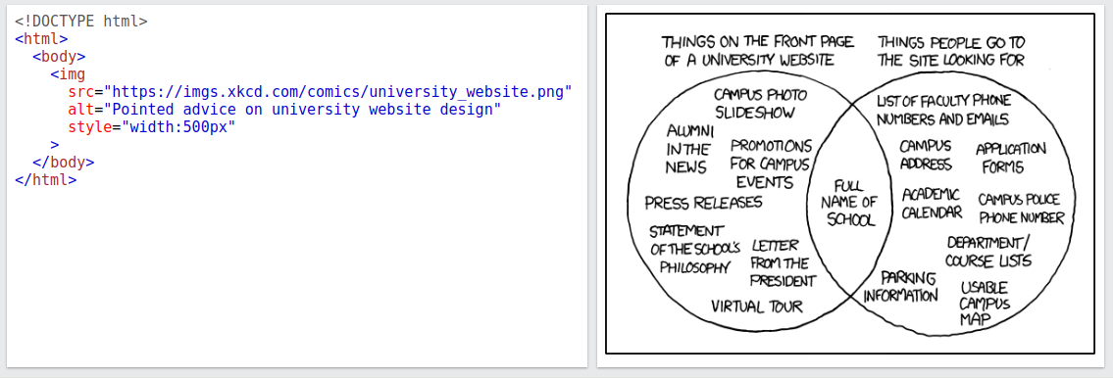
HTML images
All HTML tags can have a list of attributes which appear between its name and the right bracket of the opening tag.
Images are inserted into a document with the <img/> tag with the src attribute.
The alt attribute provides text for if the image can't be displayed or for screen readers.

Slide 10
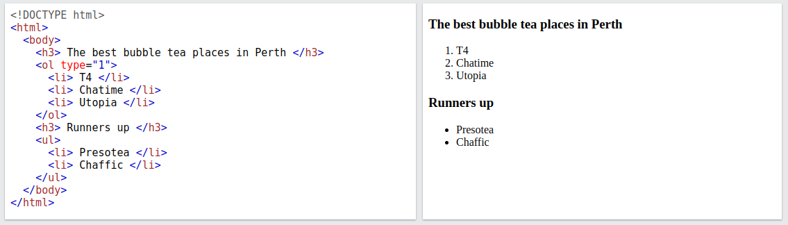
HTML lists
There are two types of lists:
An ordered list used the <ol> tag.
An unordered list uses the <ul> tag
Elements of a list are added as contents of the <li> tag.
The type attribute of <ol> can be used to change the list marker (e.g. to letters).

Slide 11
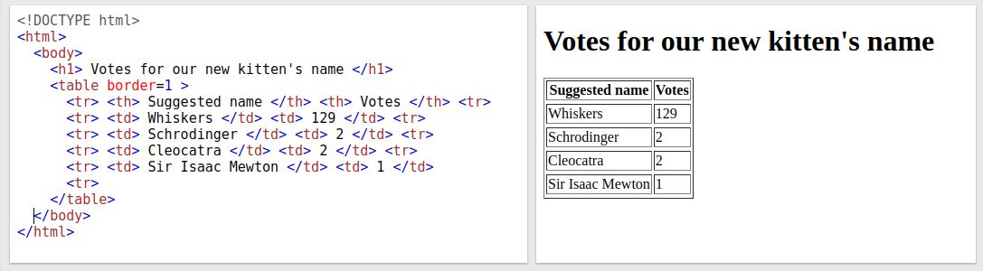
HTML tables
A table is a matrix of cells, each possibly having content
A table is specified as the content of a <table> tag
Each row of a table is specified as the content of a <tr> tag
The row headings are specified as the content of a <th> tag
The contents of a data cell is specified as the content of a <td> tag

Slide 12

HTML table attributes
The <table> element tag has various useful attributes:
The cellspacing attribute sets the distance between cells.
The cellpadding attribute sets the spacing between the cell's content and its inner walls.
The border attribute sets the width of the border between the cells. Without the border attribute, the table will have no visible cell borders.
It can be very tempting to use borderless tables to layout a webpage.... don't!
Violates semantic intent – screen readers will read it as a table.
Browsers may decide to render it as a table regardless!
Quickly gets unmaintainable as you usually need (deeply) nested tables.
Can be slow to render in the browser for various reasons...

Slide 13
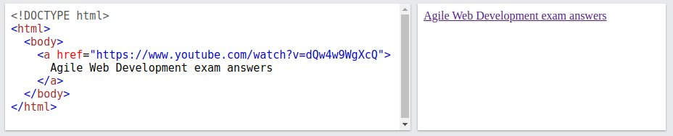
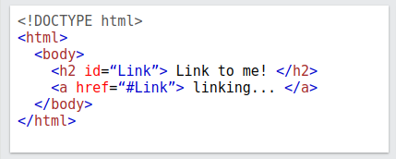
HTML hypertext links
Hypertext was one of the key selling points of the Web!
A link is created using an anchor tag <a> with a href (hypertext reference) attribute.
The content of <a> is the visual link in the document (can be images, text etc.)
When linking within the same page or same website use relative rather than absolute addressing, e.g. you can link to elements in the same document, use an id attribute:
Links can point to any file, not just HTML.

Slide 14
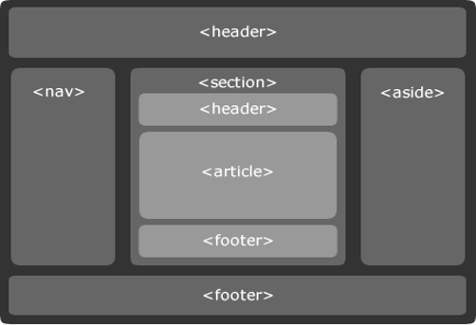
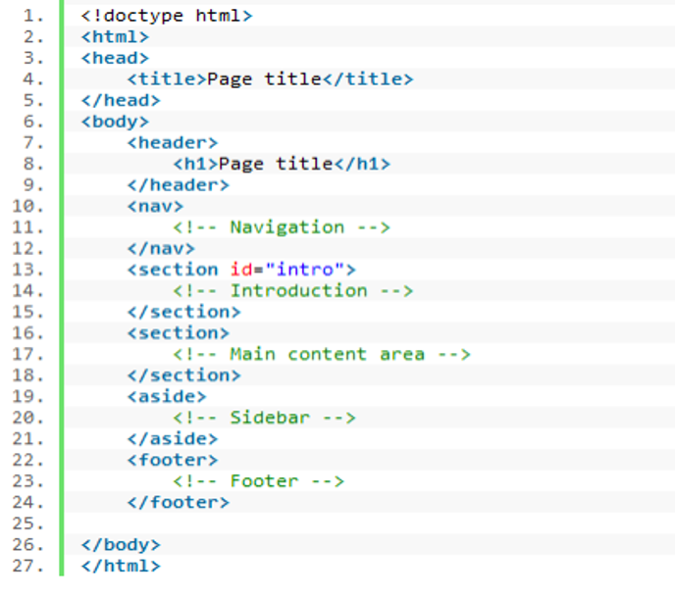
HTML advanced layout elements
The <header> element contains introductory information to a section or page.
The <nav> element is reserved for a section of a document that contains links to other pages or links to sections of the same page.
The <section> element represents a generic document or application section. It acts much the same way a <div> does by separating off a portion of the document.
The <article> element represents a portion of a page which can stand alone such as: a blog post or a forum entry.
The <aside> element represents content related to the main area of the document. Usually expressed in sidebars that contain elements like related posts, tag clouds.
The <footer> element is for marking up the footer of, not only the current page, but each section contained in the page.

Slide 15
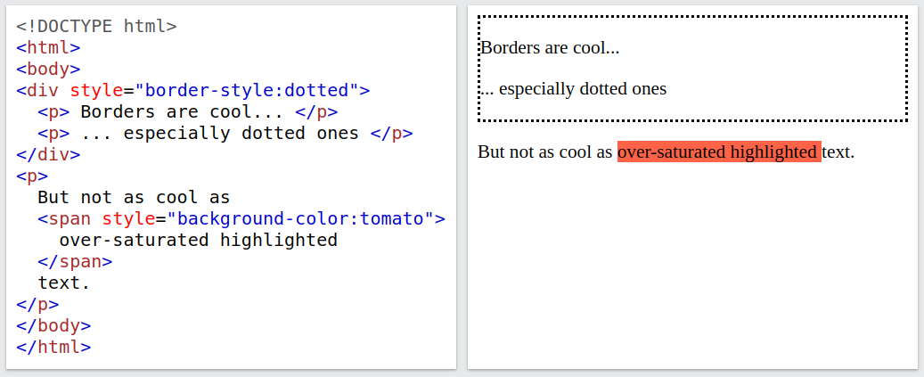
Span and div tags
For various reasons it often useful to group arbitrary collections of elements, e.g. for common formatting, or drawing a box round them, etc.
This the purpose of following two elements, which, by default, do not render to anything on the page:
<span> - groups content on a single line, e.g. words in a sentence.
<div> - groups content in a multi-line block, e.g. several paragraphs or images.

Slide 16
HTML forms
Notes:
16

Slide 17
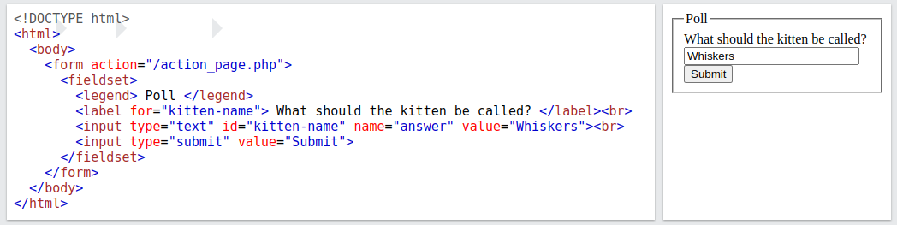
HTML form elements
A <form> element is the standard way to get information from the browser to a server.
Within a <form> you can add <input> elements to automatically create widgets that gather information (e.g., text buttons, radio buttons and checkboxes).
<input> elements can be grouped with <fieldset> element.
Labels for <input> elements can be created using <label> elements and linked using the for attribute whose value should match the id attribute on the corresponding input.

Slide 18
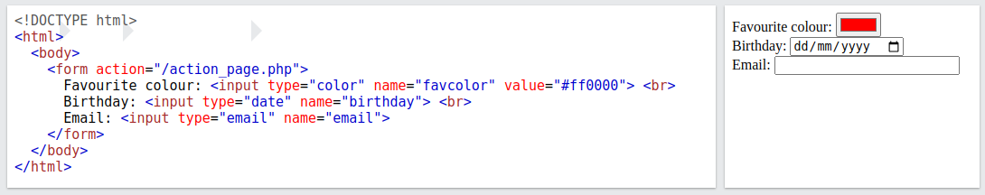



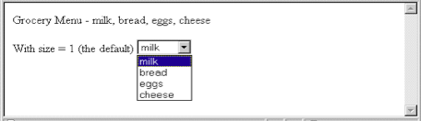

HTML form input attributes
The type attribute on the input element sets how it renders: button, checkbox, color, date, email, file, image, month, number, password, radio, range, reset, search, submit, tel, text, time, url, week etc.
The value attribute sets the input's initial value.
The readonly attribute means the user can't edit it.
The placeholder attribute provides a hint for what sort of value should be entered.
The required attribute forces the user to enter a value.
Lots of attributes are dependent on the type used, e.g. autocomplete, min, max

Slide 19
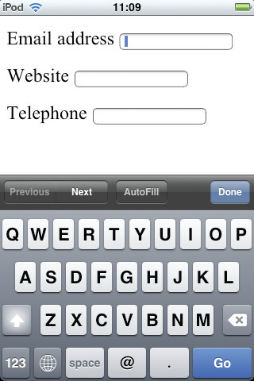
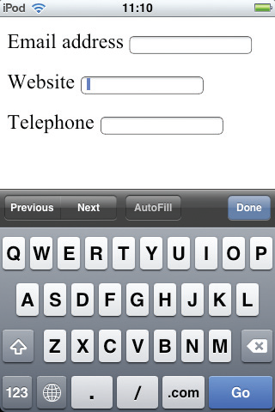
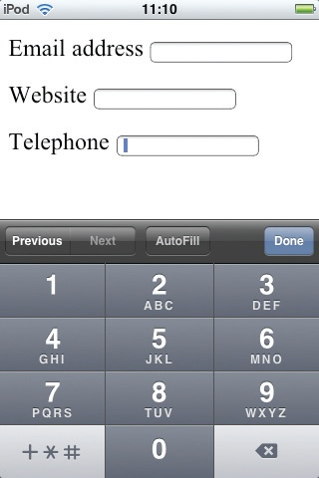
Using the right input type
By using the correct semantic input type, browsers can make the user's life easier.
For example, by using email, url and tel instead of a plain text, the on-screen keyboard changes accordingly:

Slide 20
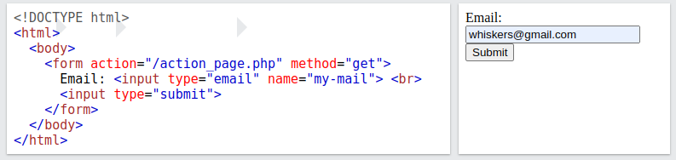
Submitting a form
Forms have a special input type called submit which generates a submission button.
When the submission button of a form is clicked, the form's current values are sent to the server at the URL specified by the value of the action attribute of the <form> tag.
Each input's value is sent as a key-value pair where the key is the value of name attribute.
The method attribute on the <form> tag determines which protocol to use to transmit the values. The get method appends the form's values in the URL of the server request. The post method instead encodes the values in the body of the server request. See Lecture 9.
Will send the request "/action_page.php?my-mail=whiskers@gmail.com"

Slide 21
HTML form validation
How to ensure the user enters valid data in the form?
Approach 1: use the native validation provided by HTML.
Automatic basic validation on email, url and tel input types.
Various type-dependent validation attributes available:
For numeric inputs: max, min, step
For textual inputs: maxlength, pattern
Approach 2: the more flexible approach is to use JavaScript in the browser to write code to check your inputs (see Lecture 5).
Regardless of the approach, client-side validation is trivial to bypass!
Therefore, always validate your values on the server as well!

Slide 22
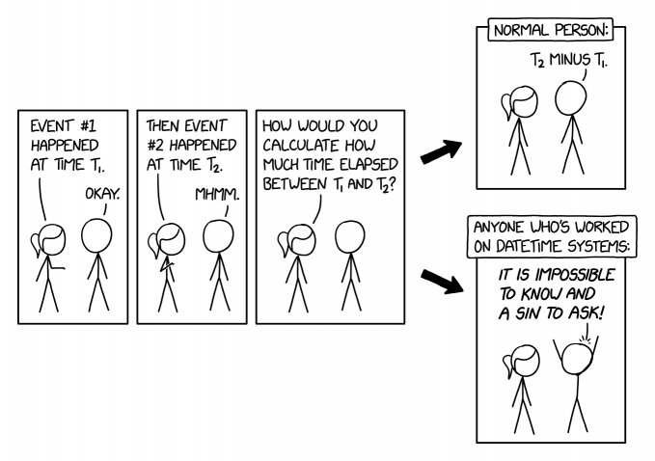
HTML dates and times
Notes:
22

Slide 23
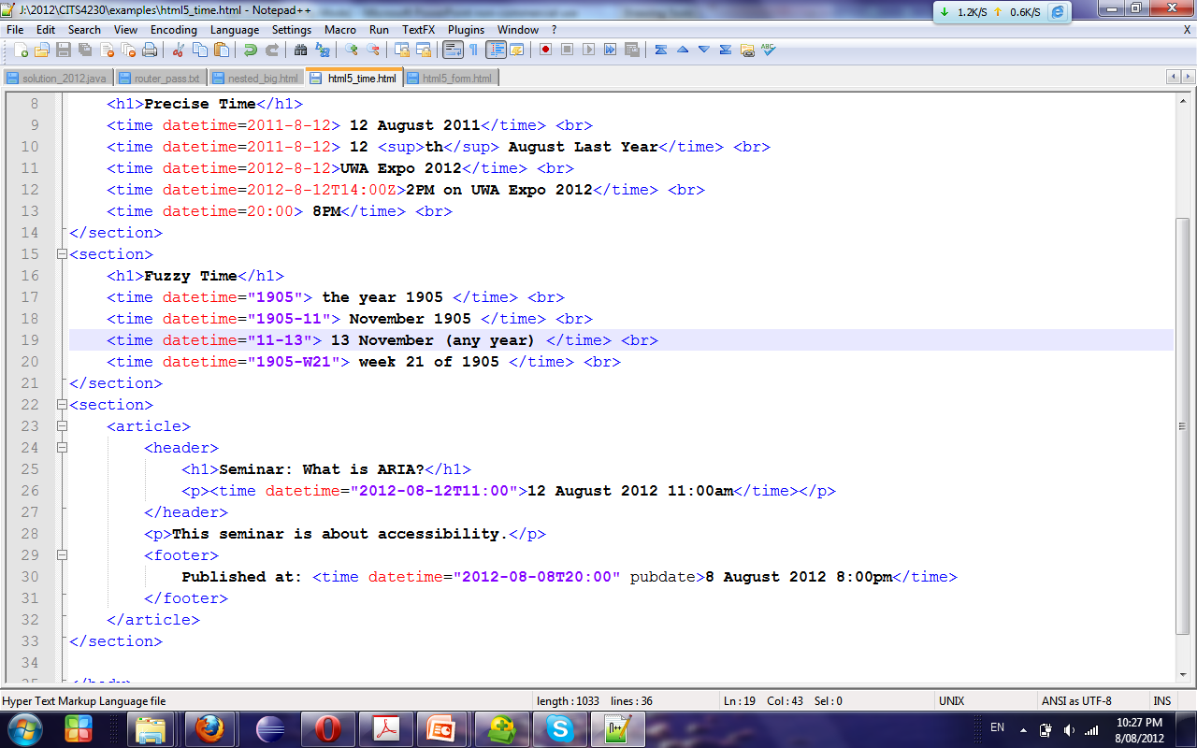
HTML time element
The <time> element can represent durations where the contents is the value shown to the user and the datetime attribute encodes length.
Prefix "P" for period, "D" for days, "H" for hours, "M" for minutes and “S" for seconds, e.g. <time datetime="P4D"> is a duration of 4 days,
using a "T" after the "P" marker allows you to be more precise, e.g. <time datetime="PT23H 9M 2.345S"> is a duration of 23 hours, 9 minutes and 2.345 seconds.
The pubdate attribute is a Boolean to indicate that the <time> element represents when the page was published.

Slide 24
HTML datetime inputs
HTML has various <input> types specifically for dates and times.
These input types record timestamps with some subset of the standardized format
YYYY-MM-DDThh:mm:ss.Z
where Y = year, M = month, D = day, h = hour, m = minute, s = second, Z = timezone.
Take, for example, the start time of Taylor Swift's Era's tour in Australia, 7:30pm on February 16th, 2024:
datetime - 2024-02-16T19:30:00.+11 - a year, month, and day in combination with hours, minutes, and seconds and time zone information.
datetime-local - 2024-02-16T19:30:00 - is the same but without the time zone information.
date - 2024-02-16 - a year, month, and day.
month - 2024-02 - a year and a month but without a day.
time - 19:30:00 - hours, minutes, and seconds.
Weirdly there is no year type....

Slide 25
Useful HTML resources
Notes:
25

Slide 26
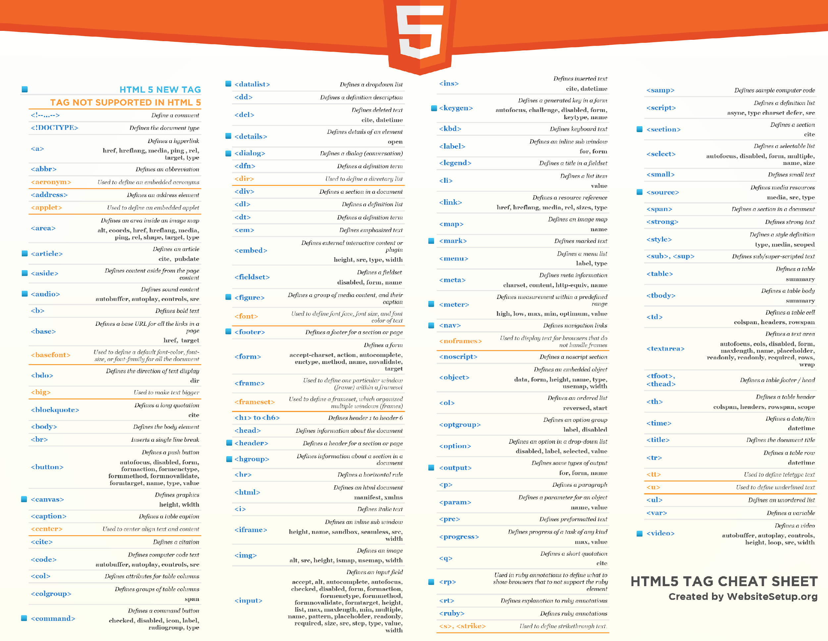

Slide 27
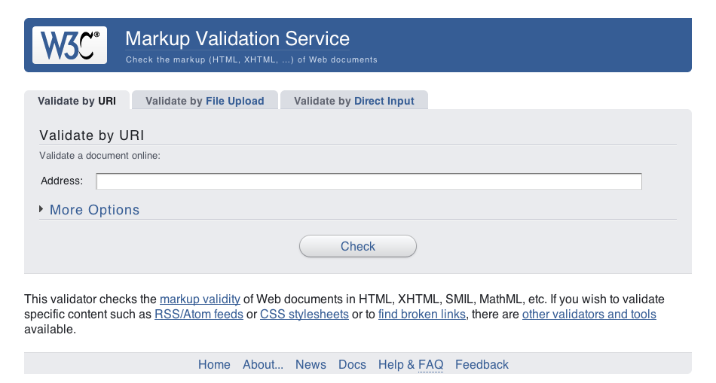
Validation
W3C HTML Validation Service: http://validator.w3.org/

